Slide 1
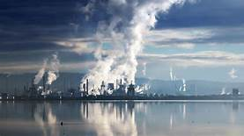
Greenhouse Gas
Group 3: Jazmine Yuen, Vanessa Cox, Carly Magiera, Astrid Uchicua

Slide 2
Why did we choose this topic?
We chose this topic because we wanted to see and create with what we have learned from the class. With that we have done research and have found that EPA has released its first annual publication of state greenhouse gas (GHG) data consistent with the national Inventory, meaning state GHG totals when summed, will equal national
totals in the Inventory of U.S. Greenhouse Gas Emissions and Sinks.

Slide 3
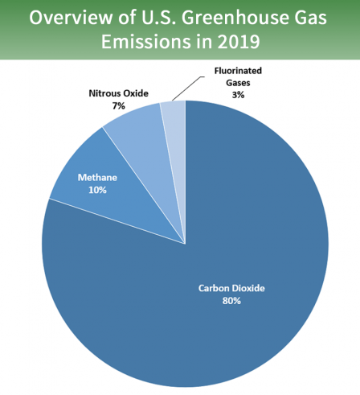
Water vapor, methane, ozone, nitrous oxide, and carbon dioxide are all classified as greenhouse gases. Carbon dioxide is the most prevalent of all greenhouse gases, which is one of the reasons it comes up so frequently when discussing climate change issues.

Slide 4
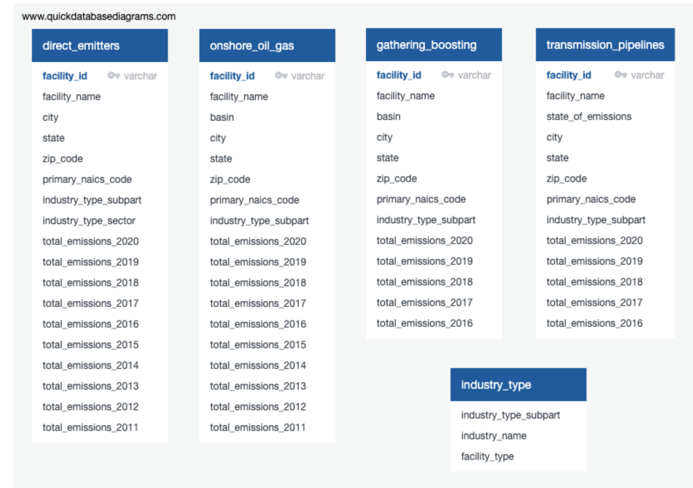
The total emissions by industry type by sector. K means, clustering the data into high, mid, low emissions classes
This shows the data into high, mid, low emissions classes

Slide 5
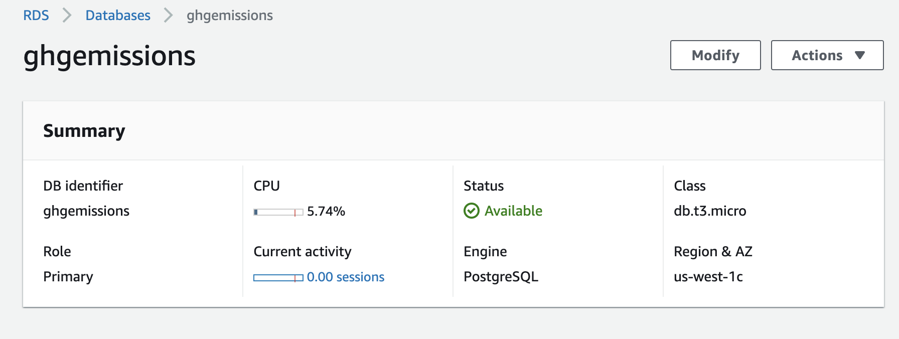
AWS Database and pgAdmin

Slide 6
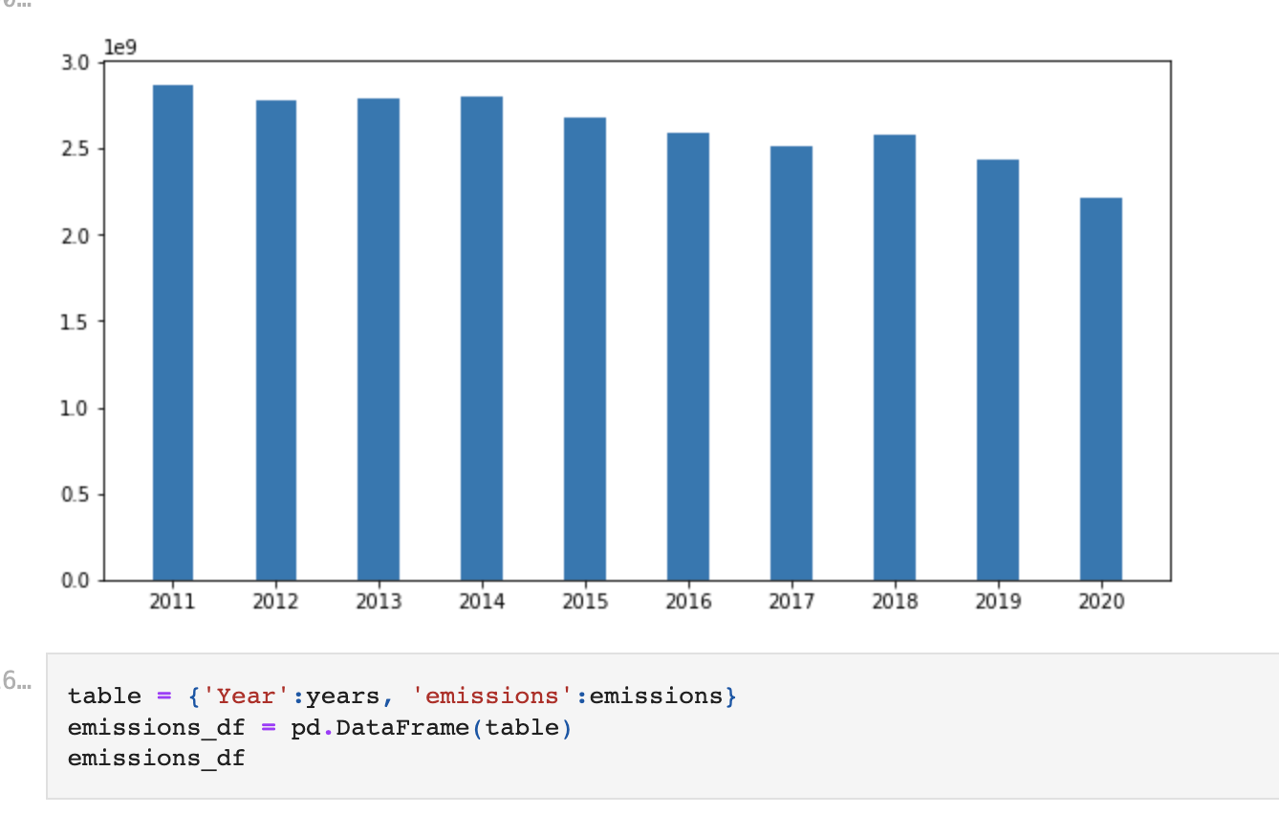
During the two years to four years, we can see a change..
Predict emissions two years or four years by sector, by highest emitters

Slide 7
Machine Learning Model

Slide 8
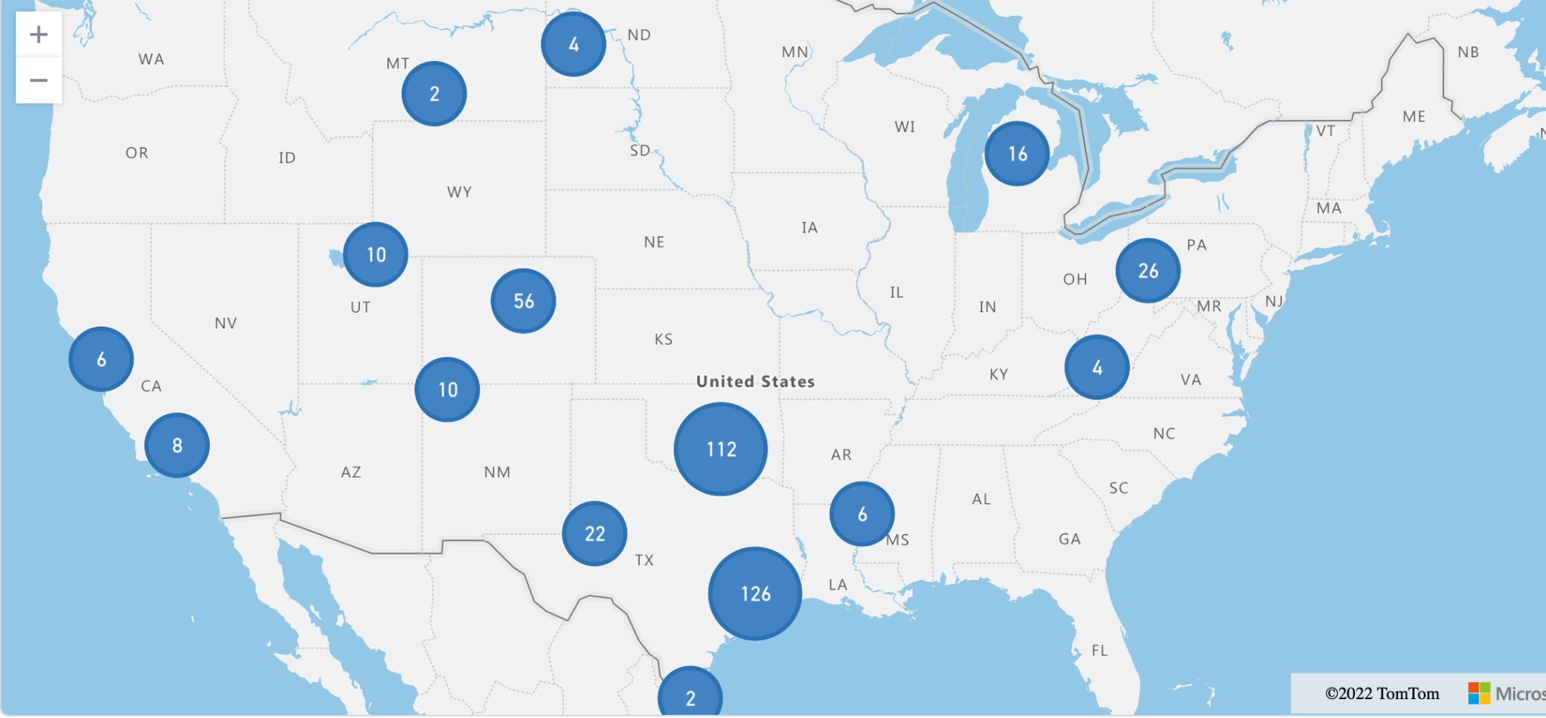
Other visualizations
Basin Map

Slide 9
Dashboard

